Slide 1


Getting Better Results from Safety - A Psychological Approach
Presented by:
Shanna Dunbar BSN RN COHN-S

Slide 2




You are…
You have…
You want…

Slide 3


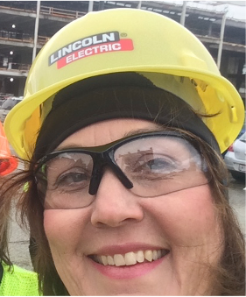
Total Worker Health®
Strategist
BWC-Certified Transitional Work Program Developer
Occupational Health Nurse
Total Worker Health® Strategist

Slide 4






Total Worker Health® Paradigm
Health
Safety
TWH
Wellness
Well-being

Slide 5



Psychological Safety

Slide 6
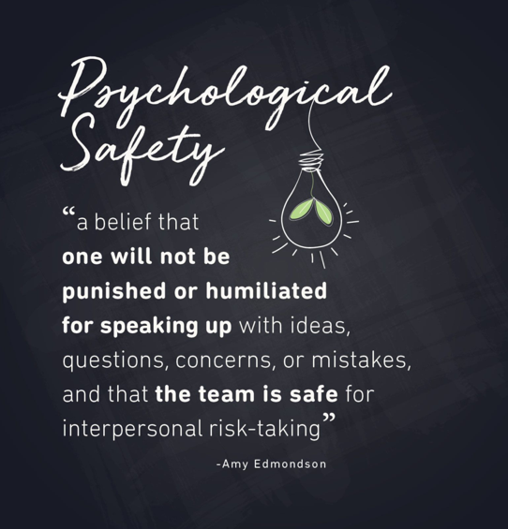


Slide 7
Psychological Safety is being able to:
Give and receive feedback
Raise issues and concerns
Disagree
Ask for Clarification
Ask difficult questions
Ask for Help
Offer solutions to problems
Admit errors

Slide 8
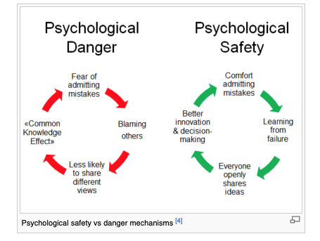
https://www.weforum.org/agenda/2016/04/team-psychological-danger-work-performance/

Slide 9
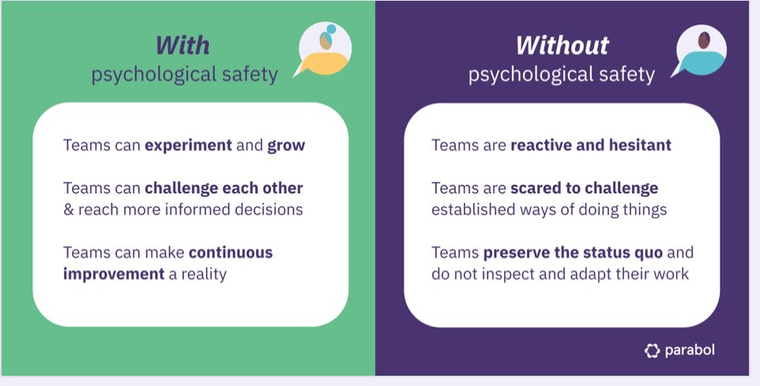

Notes:
Anxiety zone can occur when employees are reprimanded for having an injury—blame game
Apathy can occur when we do not listen to our employees who see something and tell us and then we ignore it and someone gets hurt

Slide 10

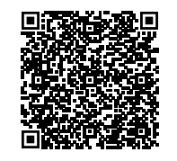

Just for you!
👷
Email me at Shanna@workplacehealthinc.com
Put PSYCHOLOGICAL SAFETY (or PS) in the subject line
Includes:
  Reference list for Psychological Safety research –detailed ppt slides
  The 5 things you can do right now to improve Psychological Safety at your workplace
  1 – 1 mentoring call with me to gain insights about your workplace

Slide 11
Psychological Safety ~
APPLIED

Slide 12
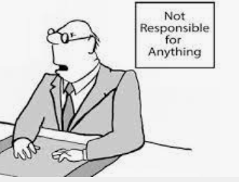
Two scenarios

Slide 13
The status quo guy
Hides own mistakes
Blames others
Authoritative
Intimidates others
Punitive
Monday morning quarterback
Tolerate toxic behavior
Lack of confrontation
‘We have always done it this way”

Slide 14
The superhero health and safety
Acknowledges own mistakes
Be open to feedback
Be curious
Asks others’ opinion
Knows and uses team members’ strengths
See what others’ need
‘See something –say something”

Slide 15
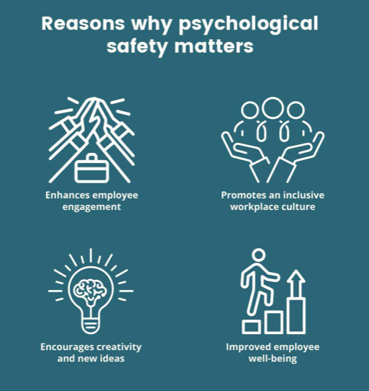
Fostering Psychological Safety

Slide 16
How do you create Psychological Safety for your team?
Build trust with OPEN communication
Listen
Allow others to challenge status quo
Be inclusive of others regardless of rank or title
Be open to all points of view
DOES NOT mean you have to ACT on all ideas --- but be open to listening
You will get better buy in from employees who are listened to

Slide 17
1. Open communication channels
2. Non-punitive reporting
3. Supportive leadership
4. Team collaboration
5. Learning culture
Fostering Psychological Safety in Injury Prevention
Notes:
Mistakes/Near misses as part of the learning process Opportunities for improvement and innovation

Slide 18
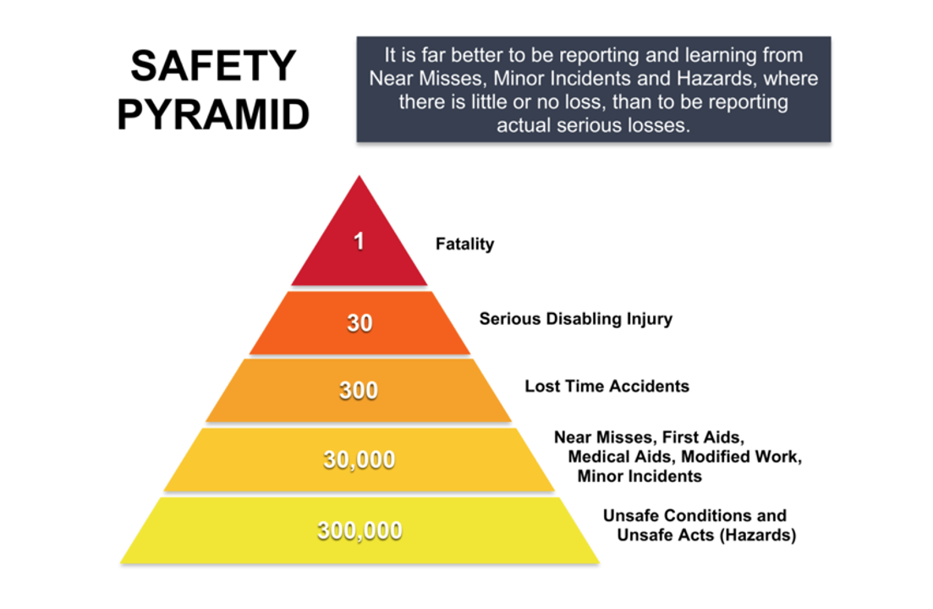

Slide 19


Slide 20

Build a PS environment
Psychological Safety is not the seed it is the SOIL – The environment in which you work
Notes:
The environment nourishes the seed - -allows it to grow. If you create this kind of environment where everyone has a voice you are demonstrating actively caring.

Slide 21
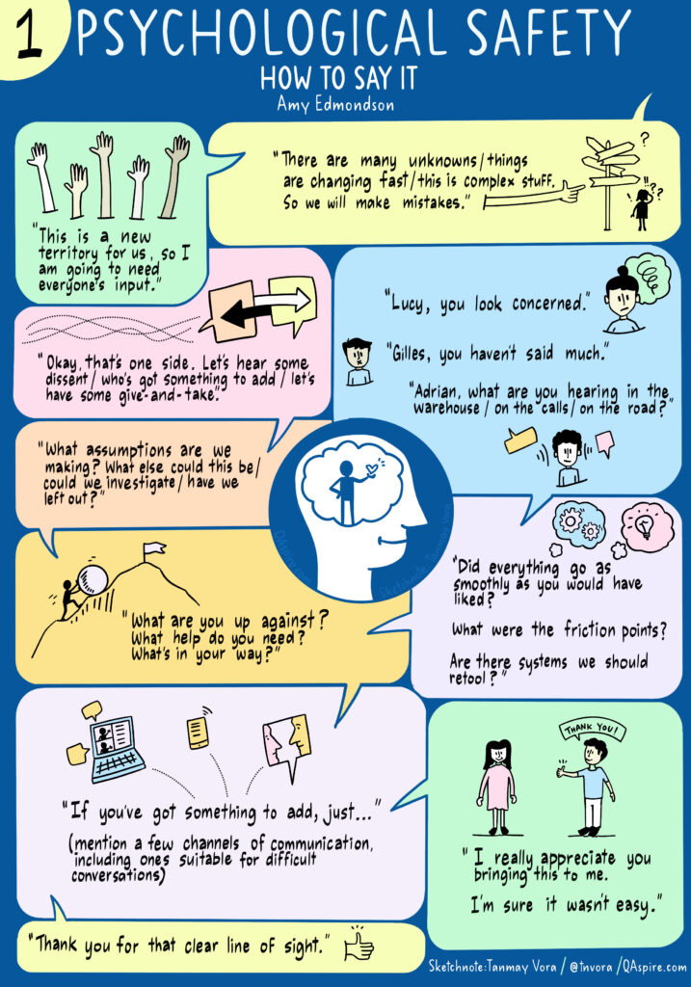
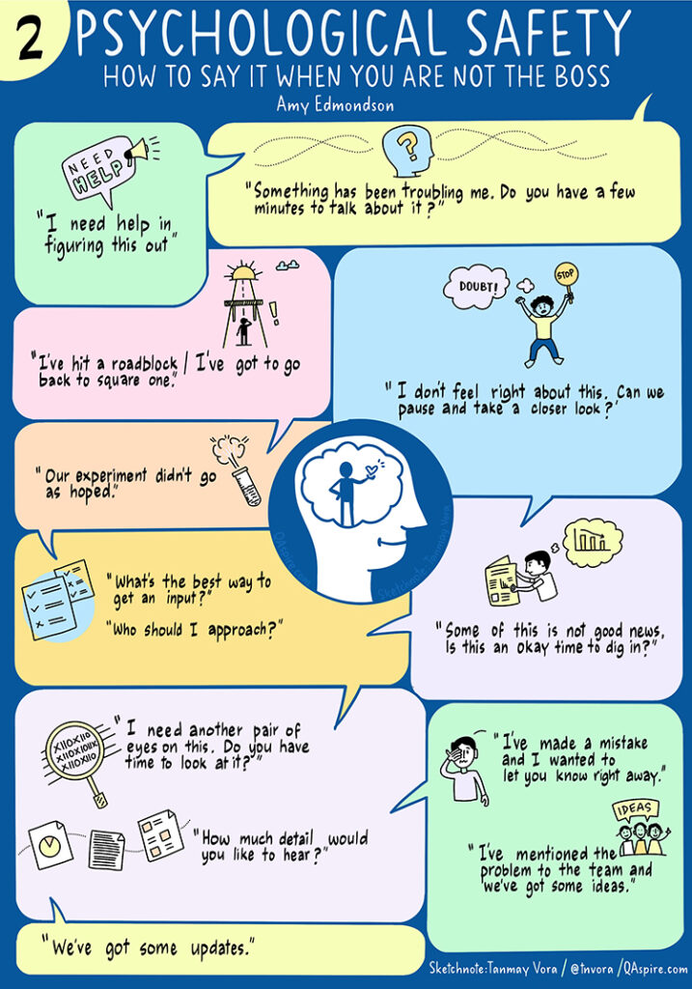
https://qaspire.com/conversations-that-build-psychological-safety/
Notes:
If no one steps up to challenge information – you maintain the status quo No new insights are offered Innovation grinds to a halt! Want a culture that admits mistakes – quickly! Share the mistakes so that the team can learn and grow from that failure Decisions will inherently become MORE effective and creative!

Slide 22
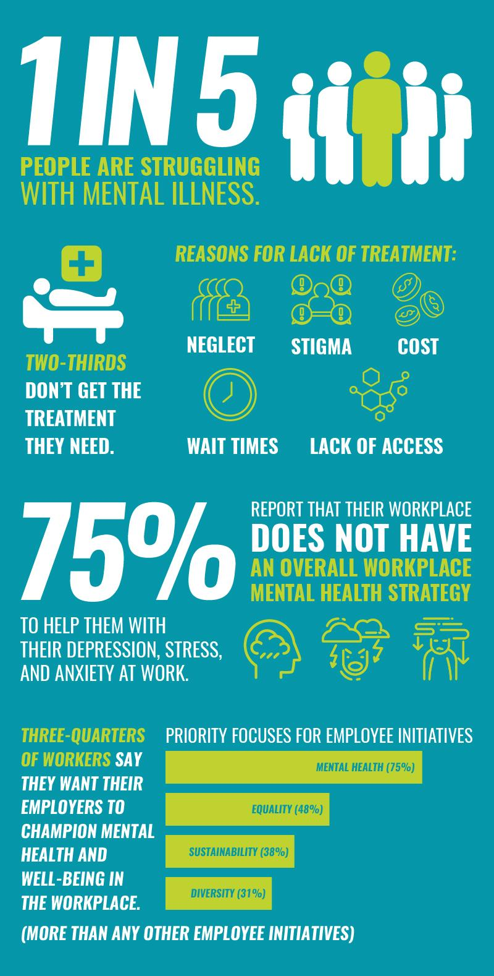


Slide 23
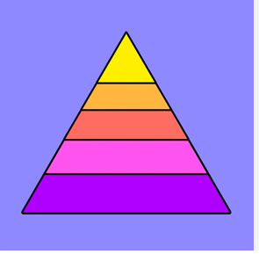
Crisis!
Minor performance issues
Mental Health in the workplace

Slide 24

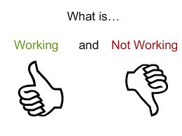
Limited Scope
Most employees needing counseling referrals
Taking 45-60 days for an appointment
High copays with insurance
Low utilization
Crisis!
Minor performance issues
Notes:
Employee went to EAP – referred for counseling – waited 60 days for an appointment then got hit with $150 per visit stopped after 3 vsiits even though it was working for him.

Slide 25


Providing Solutions!
Virtual Mental Health Services
$39.95 per month
On demand scheduling
Licensed Psychologists
Unlimited Virtual Visits
ALL household members
Psychiatrist consults
24/7 coordination of services
24/7 telemedicine for general health included
Health advocate included

Slide 26

Cost of Mental Health Care to Improvement
“…between 57.6% and 67.2% of patients improve within an average of 12.7 sessions.”*
Assume one session every 2 weeks
Traditional costs 12.7 sessions x $195 / session = $2,476.50
Rx4mentalHealth at $39.95 / month.
12.7 sessions at every 2 wks. = ~7 mos. x $39.95 = $297.65
$2,196.85
A Savings of $2,196.85!*
Trad. Health Ins.
* Hansen, N. B., Lambert, M. J., & Forman, E. M. (2002). The psychotherapy dose-response effect and its implications for treatment delivery services. Clinical Psychology: Science and Practice, 9(3), 329–343. https://doi.org/10.1093/clipsy.9.3.329
© Copyright 2024 Workplace Health Inc.

Slide 27
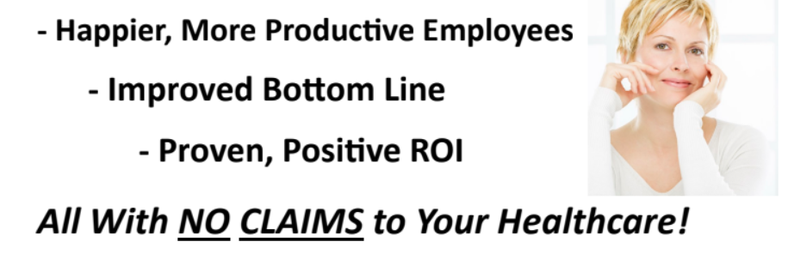
EMPLOYERS ~ Join us for the upcoming webinar:
Addressing Mental Health in the Workplace – An easier solution!
Date: March 1, 2024
Time: 12 noon Eastern
Contact Shanna@Workplacehealthinc.com to register

Slide 28
Just for you!
👷
Email me at Shanna@workplacehealthinc.com
Put PSYCHOLOGICAL SAFETY (or PS) in the subject line
Includes:
  Reference list for Psychological Safety research –detailed ppt slides
  The 5 things you can do right now to improve Psychological Safety at your workplace
  1 – 1 mentoring call with me to gain insights about your workplace

Slide 29
CLICK HERE to request TOOLKIT!
QUESTIONS?
Email: Shanna@WorkplaceHealthInc.com
Cell: (216) 329-9920 – accepting text and calls
Total Worker Health® Strategist

Slide 30



Grants up to $8200
Covers up to 100% of costs
Even if had previous TW grant in past!

Slide 31

Providing Solutions
What story does your company tell??

Slide 32


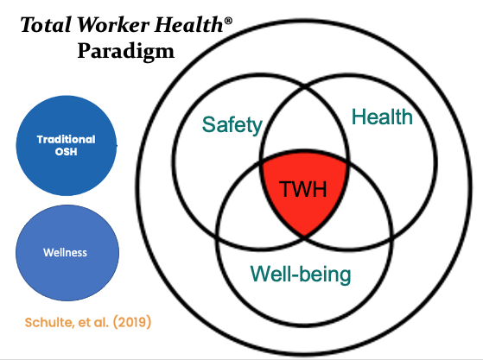
Ask Yourself…..
Assess your program…..
🧐
What’s Missing?.......ADD IT
What’s Messy? ……….FIX IT
What’s Misaligned? …. PIVOT IT
See What Total Worker Health® can do for your company!

Slide 34
CLICK HERE to request TOOLKIT!
THANK YOU!
Email: Shanna@WorkplaceHealthInc.com
Cell: (216) 329-9920 – accepting text and calls
Total Worker Health® Strategist

